Slide 1

LEADERSHIP STRATEGIES
Department of Computer Science
Instructor Name: Ms. Maria Khan
University of Engineering and Technology
Notes:
These lecture of CS-Leadership Strategies Course that is requirement of Computer Science Degree Program offered by Institute of Management ans Sciencrs

Slide 2
Week 13 Lecture 13
Notes:
During regular classes, we have covered lectures till mid term. These series of online lecture shall cover the remaining topics. At the end, we shall have an combined exam.

Slide 3
Chapter Thirteen Strategic Leadership & Knowledge Management
LEADERSHIP
Andrew J. DuBrin, 7th Edition

Slide 4
Course Learning Objectives
CLO1: Describe the nature of strategic leadership.
CLO2: Explain how to use the SWOT model to assist in strategic planning.
CLO 3:Identify a number of current business strategies.
CLO 4: Describe how leaders contribute to the management of knowledge and the learning organization.

Slide 5
The Nature of Strategic Leadership
Focuses on the major purposes of the firm
Provides the direction and inspiration for the firm
Creating an organization
Providing direction to the organization
Sustaining an organization
The strategic leader’s role is creating the organization’s future through actions of formulating and contributing to achieving the firm’s vision.

Slide 6
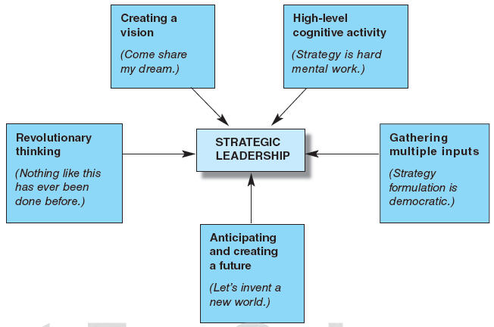
Components of Strategic Leadership

Slide 7
Five Components of Strategic Leadership
Thinking at a cognitively high level
Gathering multiple inputs form many sources
Anticipating and creative a future; setting the direction towards the future
Adopting a revolutionary or contrarian outlook
Ultimately, creating a VISION
In companies that believe in visions and strategic goals, all activities throughout the firm are supposed to support the vision and goals.

Slide 8
Conducting a SWOT Analysis
Strategic Planning encompasses those activities that lead to the statement of the organization’s goals and objectives and their chosen strategy.
Strategic Planning takes the form of a SWOT Analysis
Internal Environment Analysis:
Strengths
Weaknesses
External Environment Analysis:
Opportunities
Threats
Examines the interaction between the organization and its external marketplace

Slide 9
Examples of SWOT Elements
Strengths
Favorable Location – Talented Workers – State-of-the-Art Equipment
Weaknesses
Unfavorable Location – Untalented Workers – Outdated Equipment – Limited Capital
Opportunities
Culturally Diverse Customer Base – Changes in Technology - Deregulation
Threats
e-Commerce – Declining Market – New Competitors

Slide 10
Business Strategies Formulated by Leaders
Business strategies are often classified according to their focus of impact:
Corporate-Level Strategies
“What Business Are We In?”
Business-Level Strategies
“How Do We Compete?”
Functional-Level Strategies
“How Do We Support The Business-Level Strategy?”

Slide 11
A Sampling of Business Strategies Formulated by Leaders
Differentiation
Cost Leadership
Focus/Niche
High Quality
Imitation
Strategic Alliances
Growth Through Acquisition
High Speed & First-Mover
Product & Global Diversification
Sticking to Core Competencies
Brand Leadership
Focus on environmental stability
Creating Demand by Solving Problems
Gaining Competitive Advantage Through Hiring Talented People

Slide 12
Knowledge Management & the Learning Organization
Knowledge Management (KM) is the concerted effort to improve how knowledge Is created, delivered, and applied
Knowledge Management helps create a Learning Organization.
A Learning Organization is skilled at creating, acquiring, and transferring knowledge – and – at modifying behavior to reflect new knowledge and insights.

Slide 13
Components of Knowledge Management
Knowledge Creation
Spurs innovation through training, seminars, professional development, degree completion
Knowledge Dissemination
Allows group members access to key information and support through intranets, web portals, databases
Knowledge Application
Helps group members apply learning to their jobs through mentoring, shadowing, on-the-job training, and workshops

Slide 14
Knowledge Management Program Pitfalls
There is a human tendency to hoard information rather than share information.
Group members may prefer face-to-face sharing versus entering data into a computer.
Data entry can undermine the intuitive spark often created through interpersonal interactions.
Is difficult to decipher what information is truly useful.

Slide 15
Initiatives to Enhance Organizational Learning
Create a strategic intent to learn.
Create a shared vision.
Empower employees to make decisions and seek continuous improvement.
Develop systems thinking.
Encourage personal mastery of the job.
Encourage action learning.
Learn from failure.
Encourage continuous experimentation.
Develop political skills to make connections with and influence others.
Encourage creative thinking.

Slide 16
Summary
Strategic Leadership deals with the major purposes of an organization or organizational unit.
Strategic Leadership components include high-level cognitive ability, multiple inputs to strategy formulation, anticipating and creating a future, revolutionary thinking, and creating a vision.
Strategic Planning often takes the form of a SWOT Analysis.
Strategic leaders use many different types of business strategies.
Leaders must help their organizations adapt to the environment by assisting workers and the organization to become better learners through managing knowledge and cultivating a learning organization.

